Slide 1
Microsoft 365 Enterprise
License Map – May 2019
@AaronDinnage

Slide 2
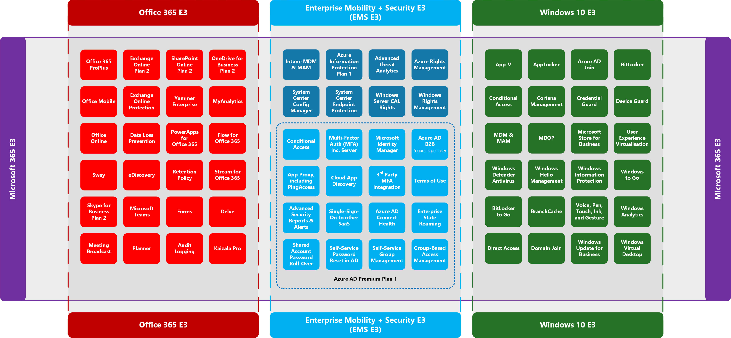
@AaronDinnage

Slide 3
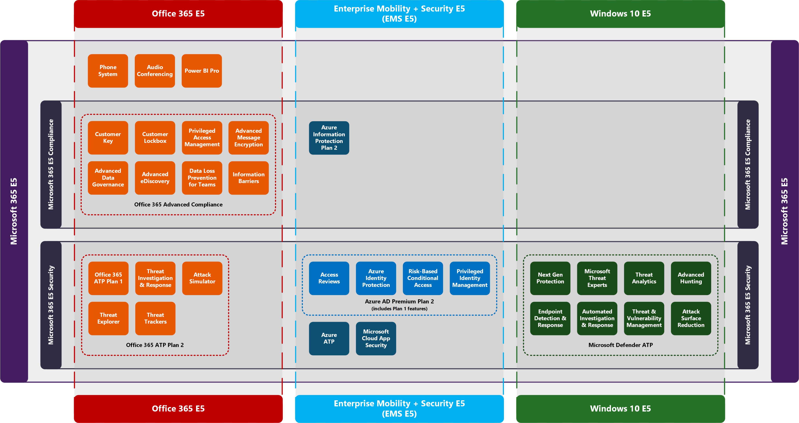
@AaronDinnage

Slide 4
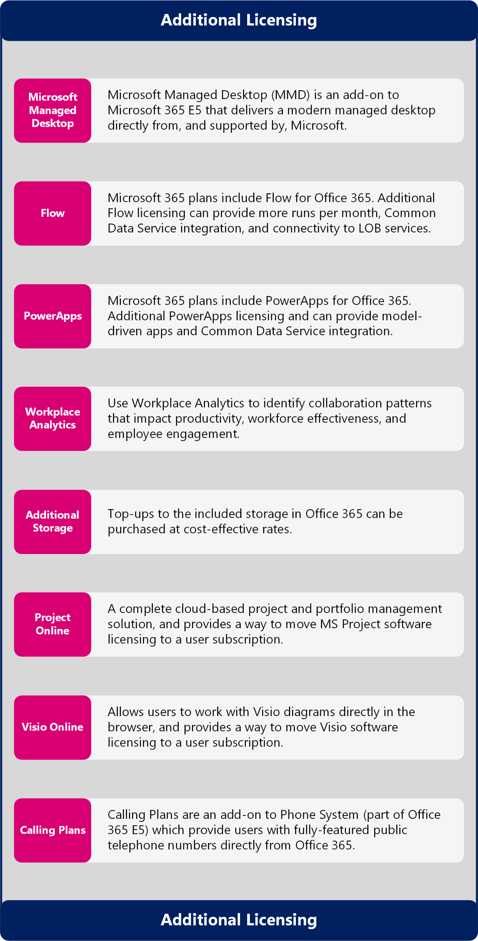
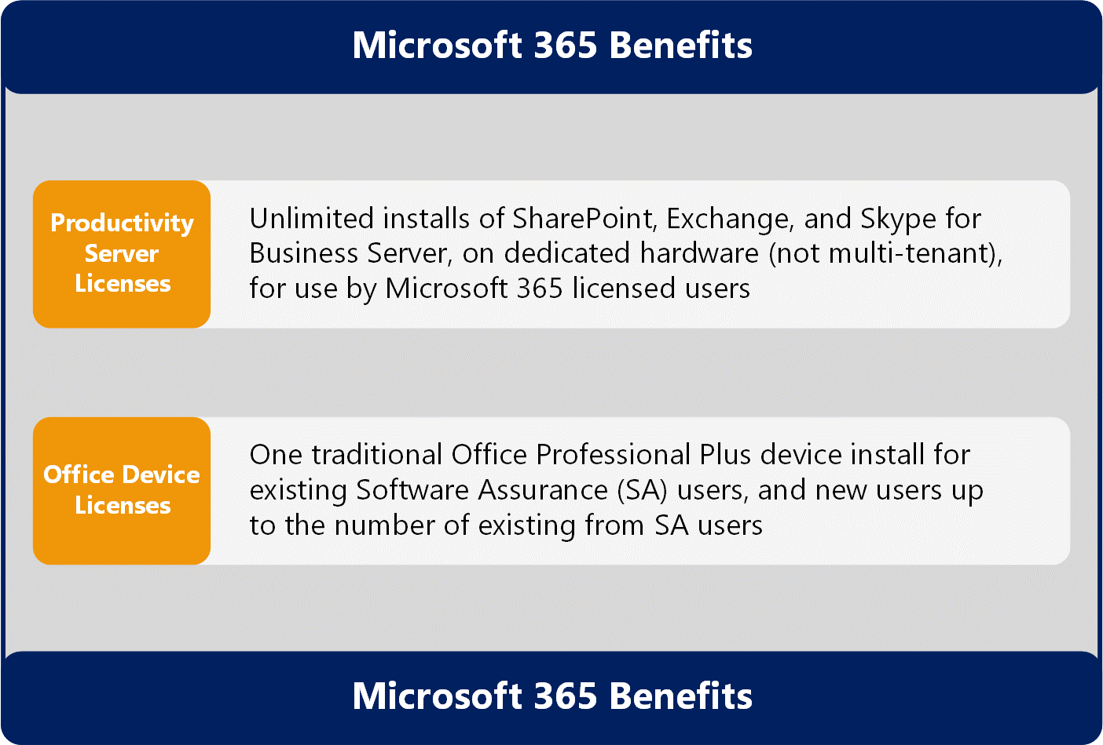
Microsoft 365 Benefits and Additional Licensing

